Slide 1

Chat with an Investment Professional
Introduction to Investing

Slide 2



Welcome!

Slide 3

Introduction
This program is provided by JA British Columbia, a not-for-profit impact organization that delivers free hands-on, immersive education in work readiness, financial health, and entrepreneurship to youth between the ages of 5 and 29.
About Me
Notes:
Introduce yourself. Introduce JA British Columbia. Get to know the students. Pass out tent cards and the student Portfolios. Explain to the students that they will be working in groups of 5 and will be setting up a retail stand in their school where they will sell products or services.

Slide 4
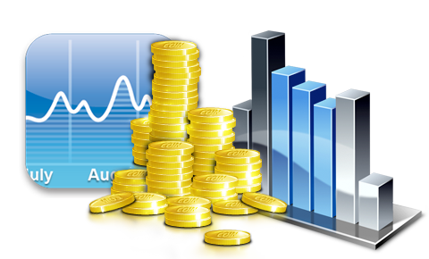
Becoming Investment Wise

Slide 5

Introductions
Notes:
Key Objective(s): (1) introduction; (2) financial literacy is very important
Volunteer introduces themselves and talk about when they first learned about money and why they think it is important that students learn about this topic.
For example, one might want to briefly touch on:
A first investment as a young person (ex., buying a Canadian bank stock)
What turned them on to a career in investment management
If one had an unconventional beginning to the industry (i.e., not from a finance family, or a traditional financial education) – to demonstrate that the industry can be accessible to anyone
The impact that early investing can have on a person’s financial future

Slide 6
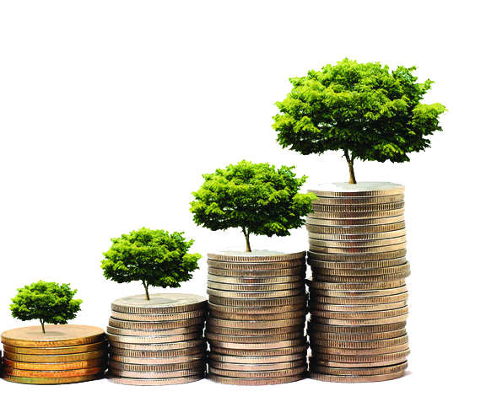
Becoming Investment Wise
What is Investing?
Putting money into something to help it grow.
Using your money to make more money (generate a profit).
When your money grows, you are improving your financial health.
Good financial health helps to:
achieve your goals,
live a comfortable life, and
have money available in case of an emergency.
Notes:
Key Objective(s): (1) while money is not everything, it helps in achieving some goals, living comfortably, and being able to address unplanned expenses; (2) investing is a tool to grow your money
[Can ask the students about some of their life goals, and then point out that there is a cost to most of these goals]
Examples of key life goals could include education, travel, buying a home
[Ask the class what they think investing is? No wrong answers]

Slide 7

Becoming Investment Wise
What are the different kinds of Investments?
There are many different kinds of investments, but today we are going to explore:
Savings accounts
Bonds
Stocks
Notes:
Key Objective(s): Introduce the different types of investments (savings accounts, bonds, & stocks) that will be discussed

Slide 8

Savings Account
Raise your hand if you have a savings account.
What is a savings account?
Why do you use it?
A savings account is like lending money to the bank.
The bank pays you a little bit of extra money at the end of each month—called “interest”—to borrow and use your money.
If we leave our money in a bank account and don't spend it, our money will stay safe, and it will grow by earning interest.
Notes:
Key Objective(s): Introduce the concept of interest/ investing in a way that could be relatable to elementary aged students via a savings account
[Before you explain what a savings account is, ask one or two of the students in the class to try and explain what a savings account is and why they might use it (if you can get the participation)]
Note that the interest for a savings account is not very much – this is not a powerful way to grow your money

Slide 9

Bonds
When you buy a bond, you are lending money to a company or government that promises that they will pay you back. Examples of bond “issuers” include:
Canada or the US
Starbucks or McDonalds
In exchange for giving a loan, you will receive interest payments, similar to a savings account, however, bonds often pay higher interest than savings accounts.
Notes:
Key Objective(s): (1) Introduce bonds—extending credit in exchange for interest payments and payback of the principal; (2) Governments and companies can issue bonds
[Can make a joke that we aren’t talking about James Bond]
Issuers = sell you bonds
[Can ask what you would expect back in return for lending someone money- students should be able to suggest that they want to be paid back. You can then mention that while your money is on loan, you can’t use it yourself, so you would want some additional compensation in return (interest).]
Interest is the cost of using someone’s money
[Companies tend to pay you more interest than government bonds]
[Bonds pay higher interest than savings accounts]

Slide 10
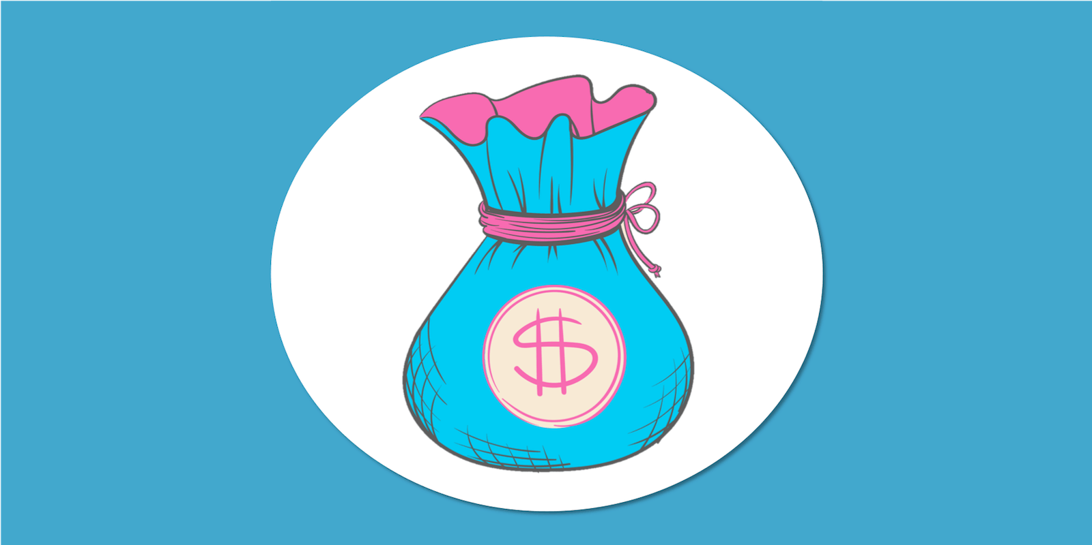
Bonds
If you leave the money with the company or government for several years until the end of the loan period or “maturity” you get two things:
what you initially invested back – called the “principal”, and
everything the bond earns – called the “interest” – for each year you held the bond.
Notes:
Key Objective(s): Reinforcing some key characteristics of a bond—maturity date, principal, and interest
The amount you are loaning and the interest you earn are known in advance and made on pre-determined dates
Bonds are known as “fixed income” securities

Slide 11
Calculating Compound Interest
Year
Principal
Interest: 2%
Principal
+
Interest
Principal x 0.02 =
Becomes next
Interest Earned
year’s principal
1
$100.00
$2.00
$102.00
2
$102.00
$2.04
$104.04
3
$104.04
$2.08
$106.12
4
$106.12
$2.12
$108.24
The magic of compounding works best the younger you are, because that means you have more time for your money to grow.
Notes:
Key Objective(s): Calculate compound interest example to demonstrate how you can grow your money if you reinvest the interest you made
Compound interest is an important concept.
Its basically earning interest on interest – if you reinvest the interest you’ve earned, you earn interest on the principal + interest.
The longer your investment horizon, the longer your money can compound.
Walk the students through year one and year two, tell them to use their calculators.
The bottom part of the chart will initially show as blank on the screen. Give the students a chance to do their calculations to complete the chart.
Ask for a volunteer to read their answers and then click to reveal each of the numbers on the chart.

Slide 12

Stocks
When you buy a stock, you buy a piece or “share” of a company and you become a part owner, or “shareholder”, of a company.
The company sells stocks and uses your money to keep the company in operation.
Owning a share of a company may also entitle you to a portion of the company’s profits – called “dividends”.
Notes:
Key Objective(s): Introduce stocks and the concept of being a part-owner of a company
Can discuss the difference in potential upside when you become a part owner of a company vs just lending money
Ex. if you lend someone your wheelbarrow and shovel to plant apple trees in their orchard, they will give you your tools back and a bushel of apples; but if you were to be a part owner of the orchard, you could have hundreds of bushels of apples if it is a good year

Slide 13


Stocks
Shares are bought and sold in an auction called the “stock exchange”.
If a company seems to be doing well, the price of a stock will go up because more people will want to buy the stock.
If the company is not doing well, the price will drop because fewer people will want to buy the stock.
Stock prices go up and down every day and do not have the promise of a pre-determined interest payment, so they’re riskier than saving accounts and bonds.
However, you can also make more money with stocks if you pick them carefully, and especially if you hold them for a long time.
Notes:
Key Objective(s): (1) Stock prices fluctuate; (2) stocks are riskier than bonds
You could make a lot of money on a stock (ex., if you bought Amazon when the company first started issuing stocks, you would have paid around $15 for one share. Now a share is worth over $3000), but if you pick the wrong company and the stock goes way down, you do not get your initial investment back (could lose all your money)
- Holding stocks for a long time can help you make money because you can wait for the stock price to go back up if the stock market has gone down

Slide 14
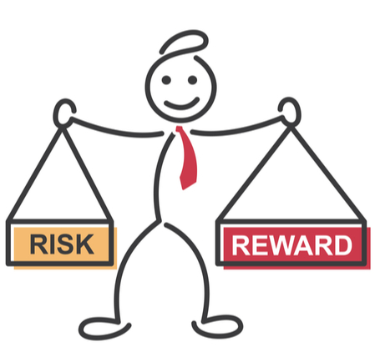

Investment Risk
Do all investments generate the same profit or return? ​
No.
“Return” on an investment is the reward or profit for the risk undertaken.
You should require a higher return to purchase an investment with higher risk (i.e. stocks).
Lower risk investments give you a lesser expected return (i.e. savings account or bonds).
Notes:
Key Objective(s): The riskier your investment, the more you should expect to get paid.
[We have already touched on stocks being riskier than bonds, so this slide helps to just reinforce the risk-return relationship]
[If asked, you can address some of the reasons why bonds are generally less risky than stocks:
Bondholders are ahead of stockholders in the line to be paid if a company goes under
Bonds carry the promise that the issuer will return the initial investment to the bondholder (when the bond matures)…there is no such guarantee with equities
Bonds pay a fixed rate of interest income (some stocks pay dividends, but there is no obligation for the issuer to do this or to keep it going)
Historically, the bond market has been less vulnerable to price swings than the stock market (more stable)
Government bonds from certain stable countries (like the US and Canada) are considered “risk free” because there is almost no chance that you won’t get your initial investment back]

Slide 15
Investment Time Horizon
You can invest your money over different time periods or “time horizons”.
Short term (less than 3 years)
Medium term (3-5 years)
Long term (over 5 years)
An investment time horizon is the amount of time you are willing to hold your investment before you sell it to make a profit.
Typically, the younger you are the more time you have to invest and grow your money.
Notes:
Key Objective(s): (1) you can invest your money over different time periods; (2) you should try and match the goal you are saving for with your investment time horizon
- The further away your investment goal (ex., if you are in high school and you are investing for retirement), the more risk you can afford to take

Slide 16
Which Investment is Best?
Tara wants to attend a gaming convention that will be hosted in her city in six months. Tara works part-time at a restaurant and has managed to save $250. The cost of the ticket is $300. Her parents won’t help her pay for her ticket, but she thinks that with her part-time job she can save the extra $50 needed to buy the ticket in six months. In the meantime, she is looking to put her money into an investment that guarantees she will not lose any of the money she invests.
Possible Retirement Years
SAVINGS ACCOUNT
BONDS
STOCKS
Notes:
Probably best that she puts the money in a savings account, so she doesn’t lose it
Savings accounts don’t pay much in terms of interest, so Tara will have to keep saving the extra $50
It would be difficult to invest in bonds with such little capital and with so little time

Slide 17
Which Investment is Best?
Jin is in grade 6, but he wants to buy a car when he turns exactly 16 (in 4 years). He is afraid of risky investments and wants to invest his babysitting money in an investment where he will earn a steady interest rate.
Possible Retirement Years
SAVINGS ACCOUNT
BONDS
STOCKS
Notes:
Jin should consider investing in bonds so he can earn a steady interest rate (especially because he has a medium-term investment horizon)
A savings account would not provide him with much opportunity for return

Slide 18
Which Investment is Best?
TJ is only in grade 7, but he is already planning for university. He recently took a class that taught him the importance of starting to invest early. To help him reach his goals, TJ's grandparents gave him $200 which he wants to invest. He doesn't plan on touching his money for at least 5 years.
Possible Retirement Years
SAVINGS ACCOUNT
BONDS
STOCKS
Notes:
TJ has a longer-term time horizon, so he could invest in stocks if he wants to take on the additional risk
He could also invest in bonds (though some sort of investment vehicle) if he is worried about losing some of the money and doesn’t want to take on the extra risk associated with stocks

Slide 19

Invest For Your Future!
Investing puts your money to work for you to help you reach your goals.
Money gives you flexibility in life and more options.
The earlier you start investing, the more money you will have later on.
As you go through life, you can adjust your investment plan as your income, goals and priorities change.

Slide 20
Thank you!

