Slide 1

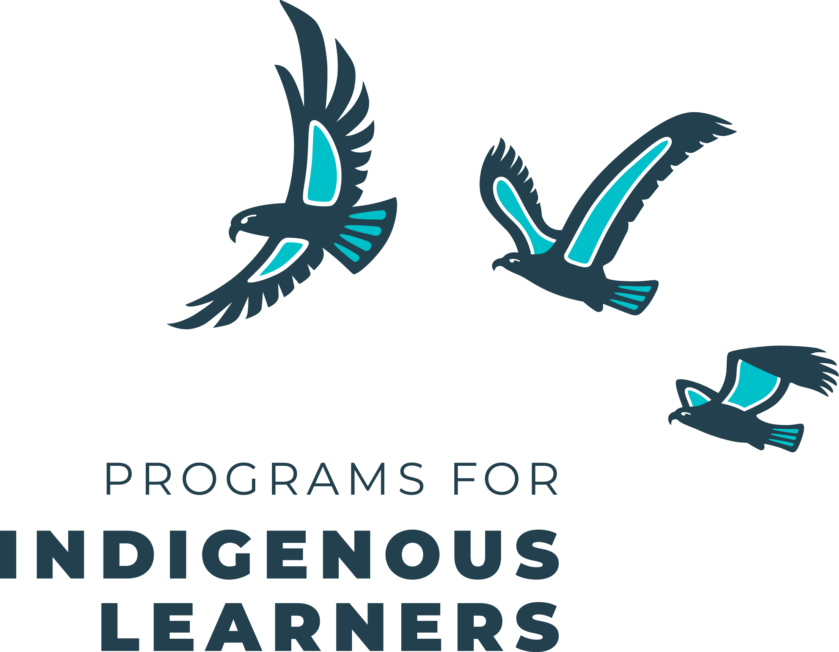
About Us

Slide 2

Our Vision
A world in which…
young people have the skillset and mindset to build thriving communities.

Slide 3
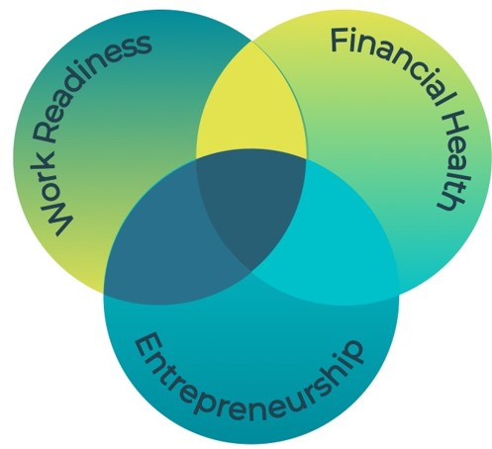
What We Do
We deliver free hands-on, immersive education in work readiness, financial health, and entrepreneurship to youth aged 5-29.
For over 65 years, our real-world training has helped young people develop the skills to build successful careers, prepare for the risks and rewards of entrepreneurship, and learn to thrive financially.
We are a proud member of JA Canada and JA Worldwide, one of the world’s largest and most impactful NGOs.

Slide 4




JABC's Reach in Indigenous Communities | 2023-24
Nearly
2,000
Students Reached
151
Programs
Delivered
31
Communities Participated
+9
Programs with 25% or more Indigenous students

Slide 5

JA Learning Experiences
Available to all schools and organizations in urban and rural communities
Provided free of charge
Presented in-class or online
Offered with flexible delivery options
Available all school year
Delivered in 1 to 4 hours, with optional extended activities available.
Supplemented with printed or digital resources at no cost
Aligned with B.C.’s curriculum

Slide 6
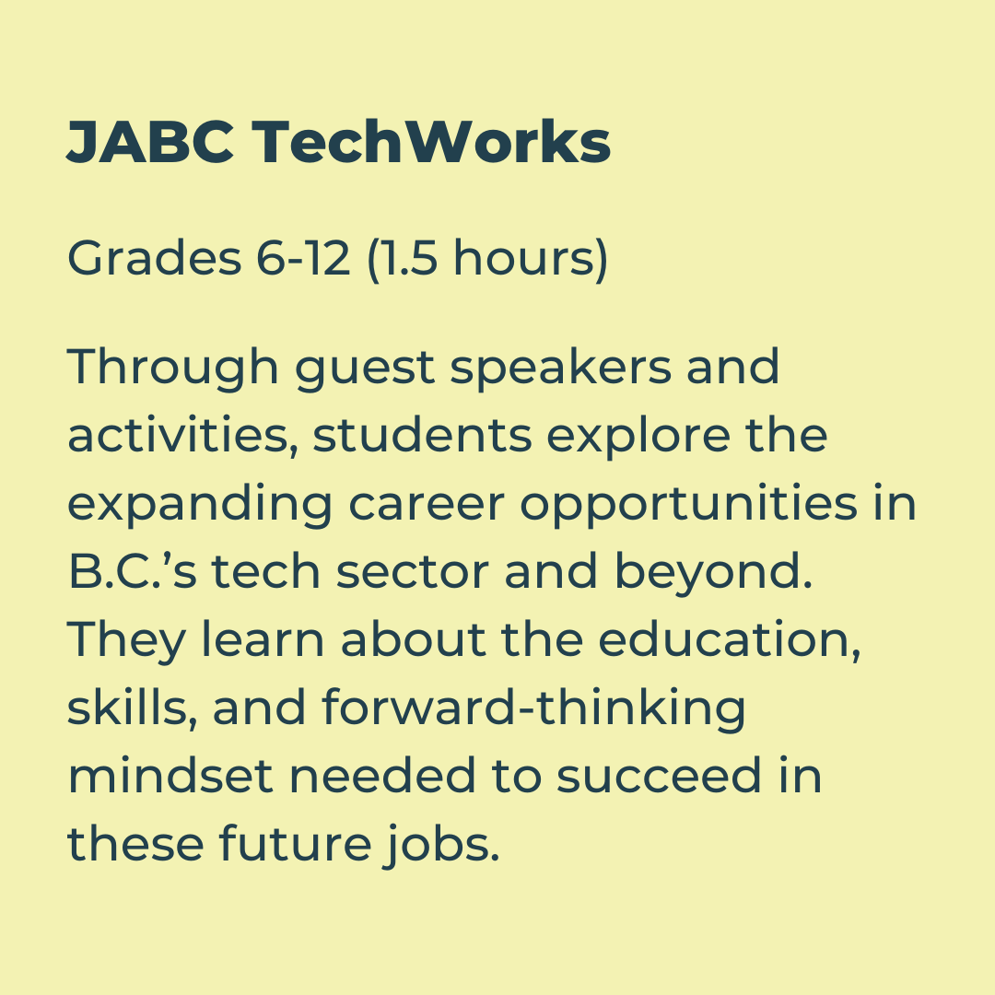
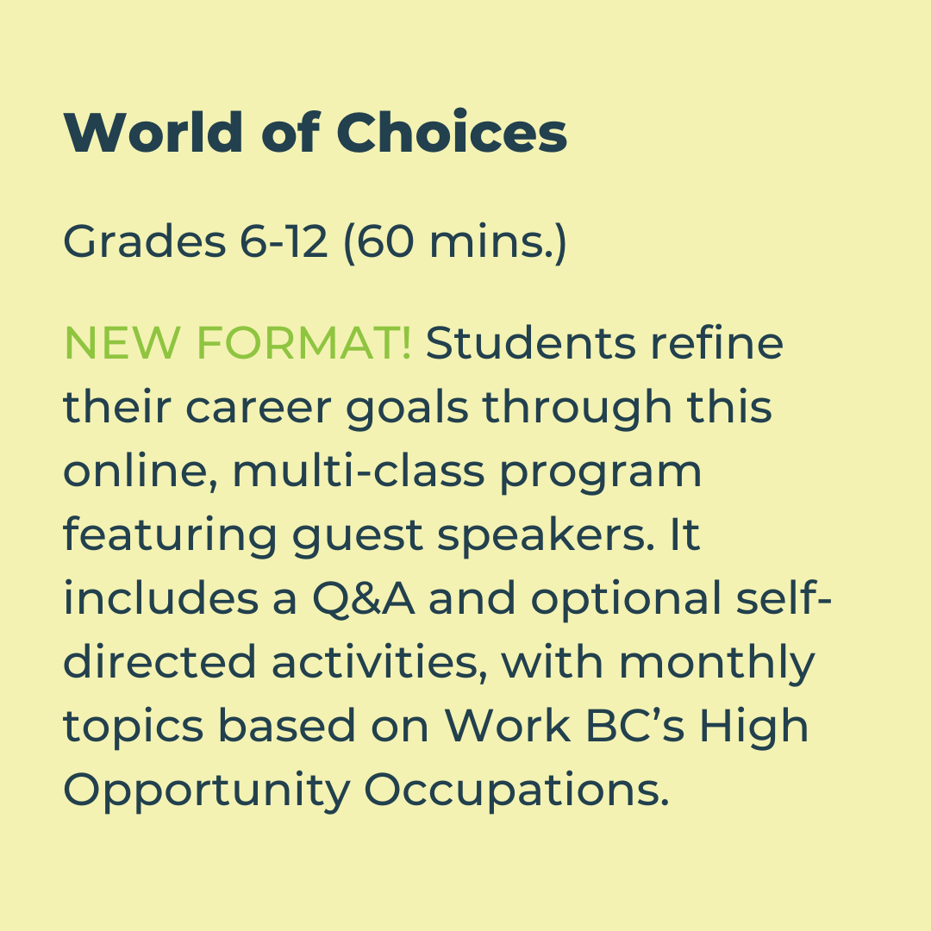

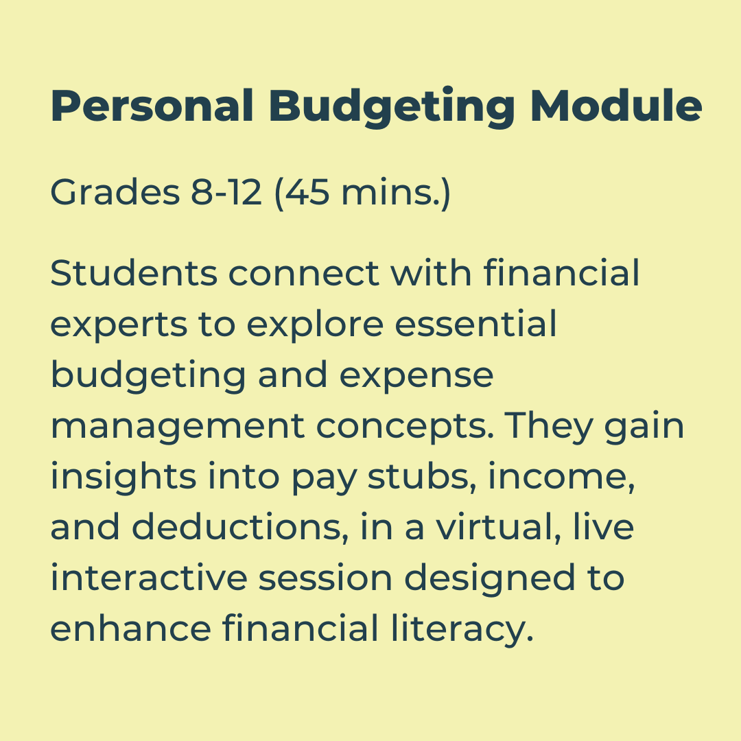
JA Learning Experiences
Capstone Programs

Slide 7
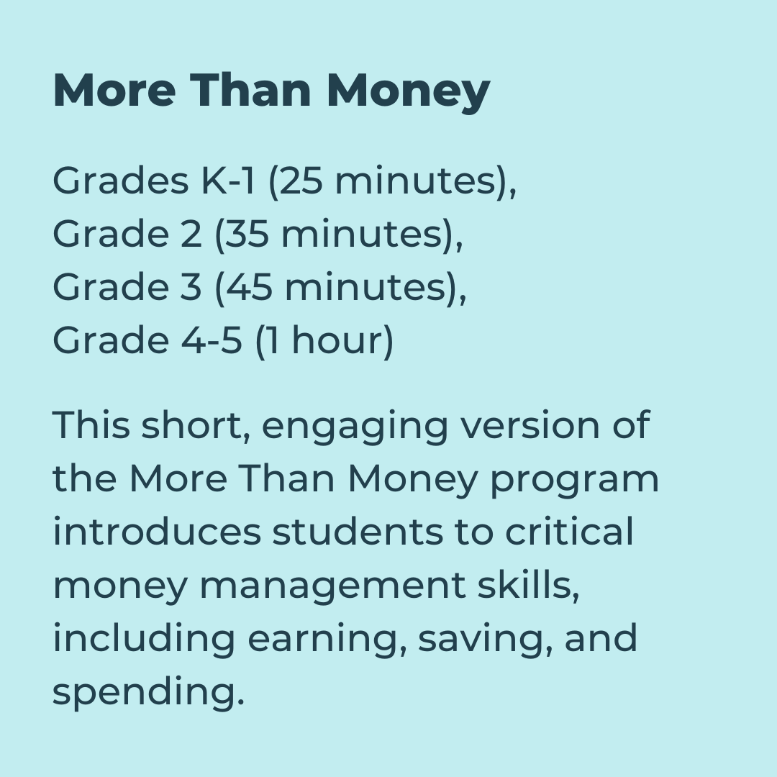
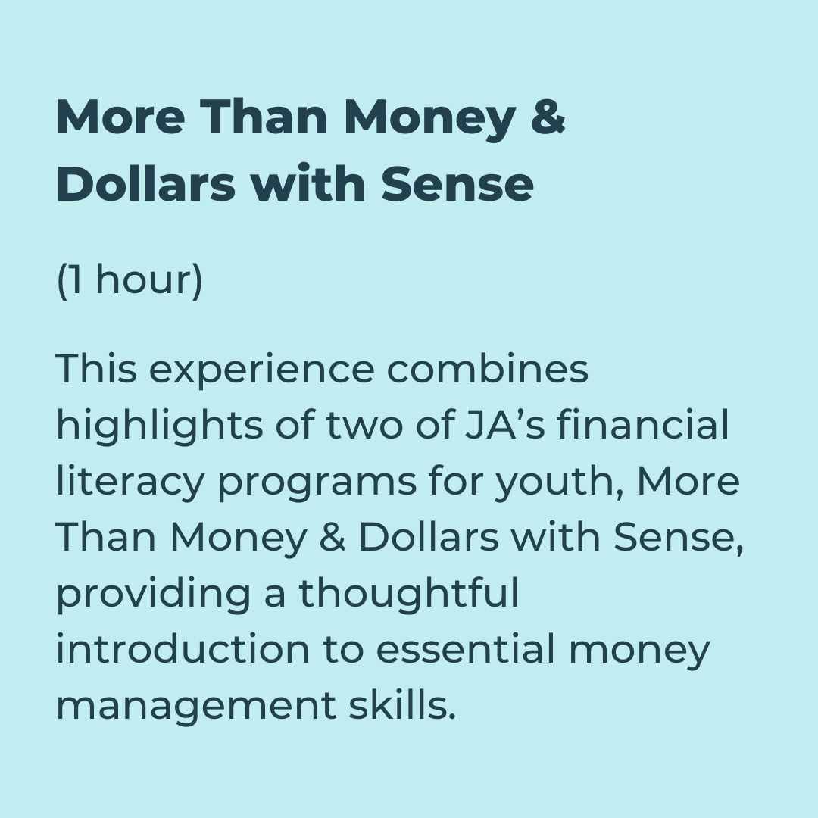
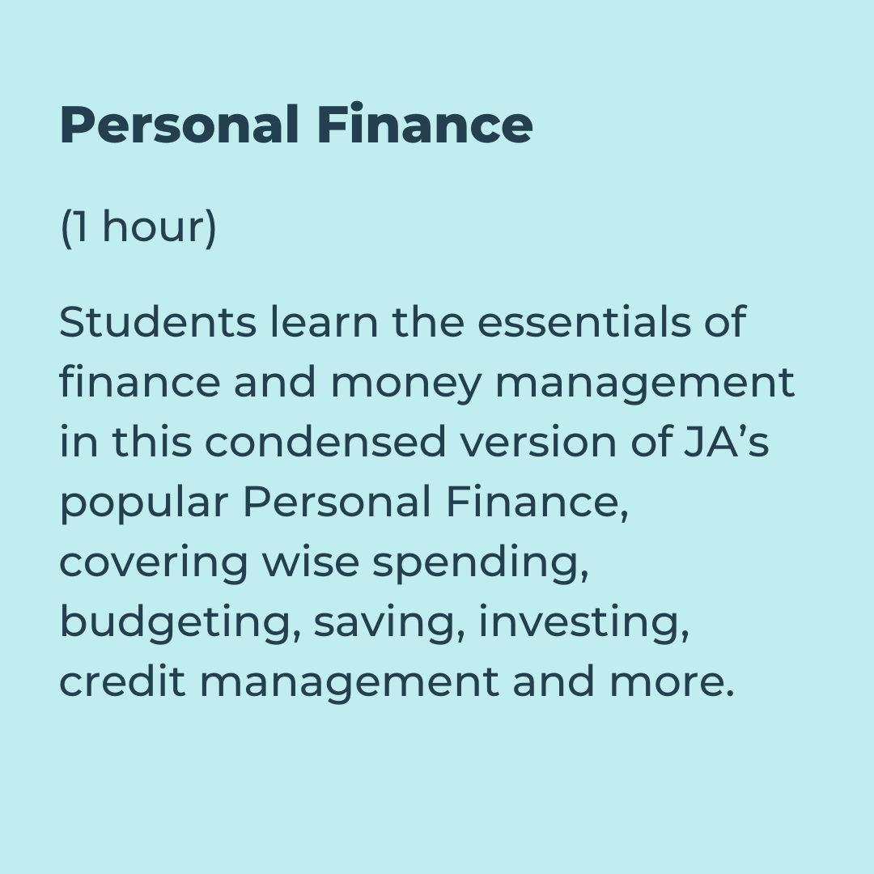
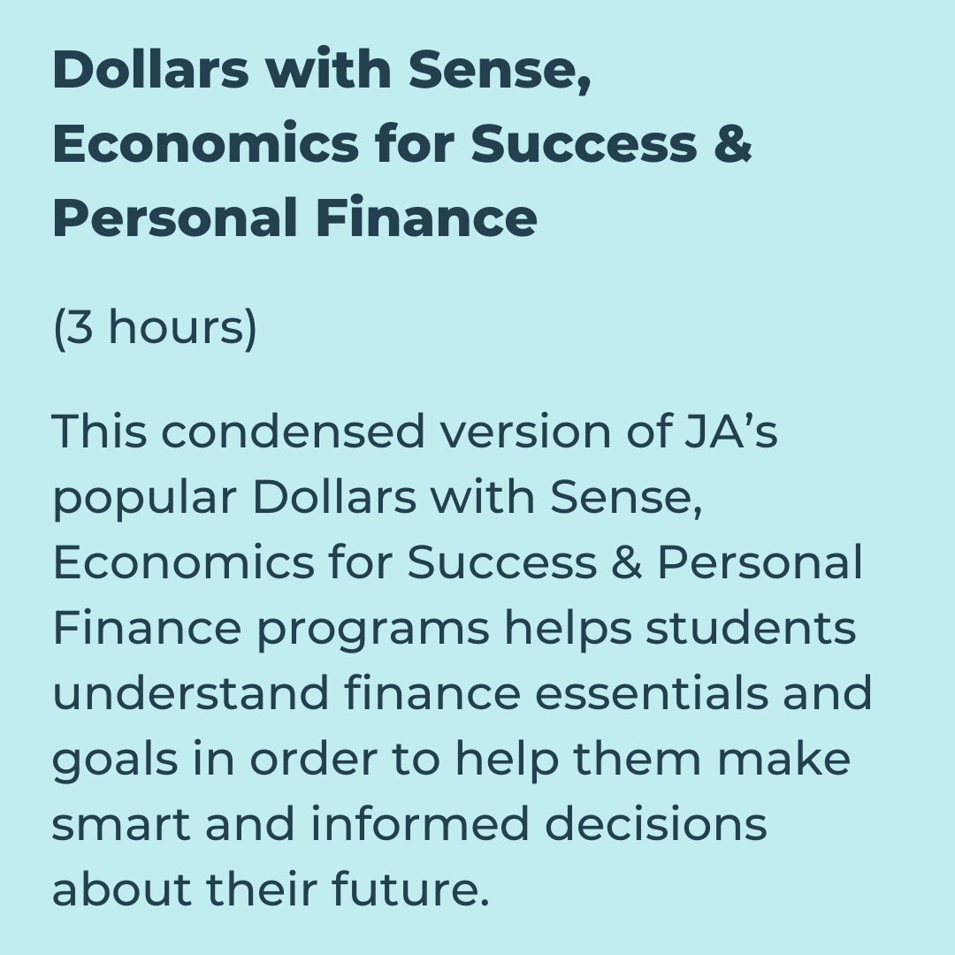
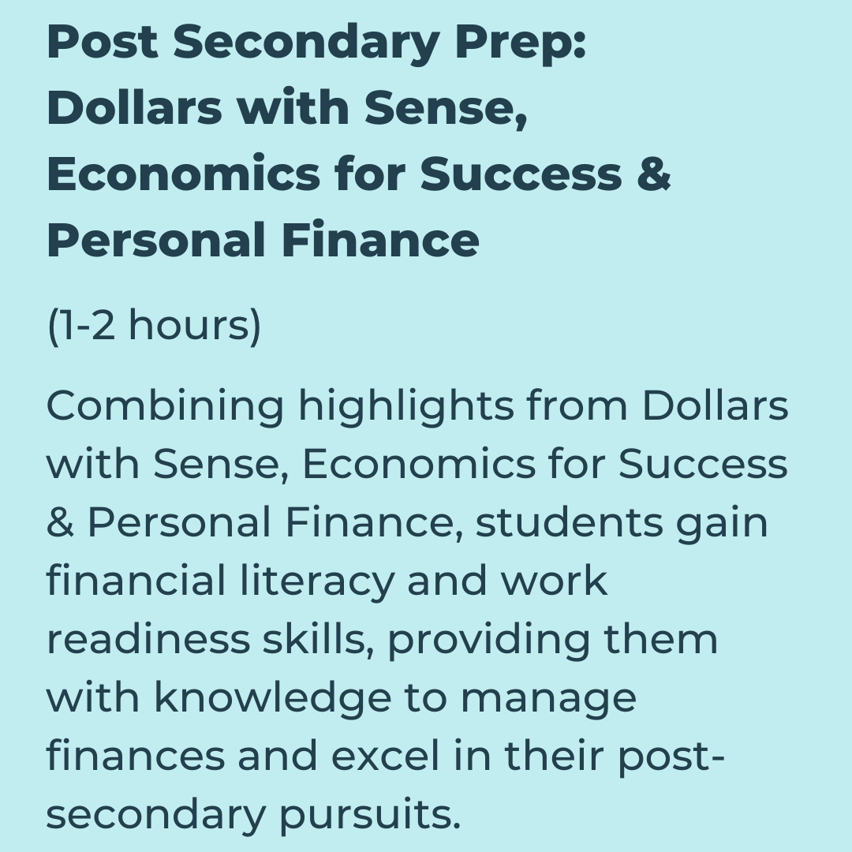


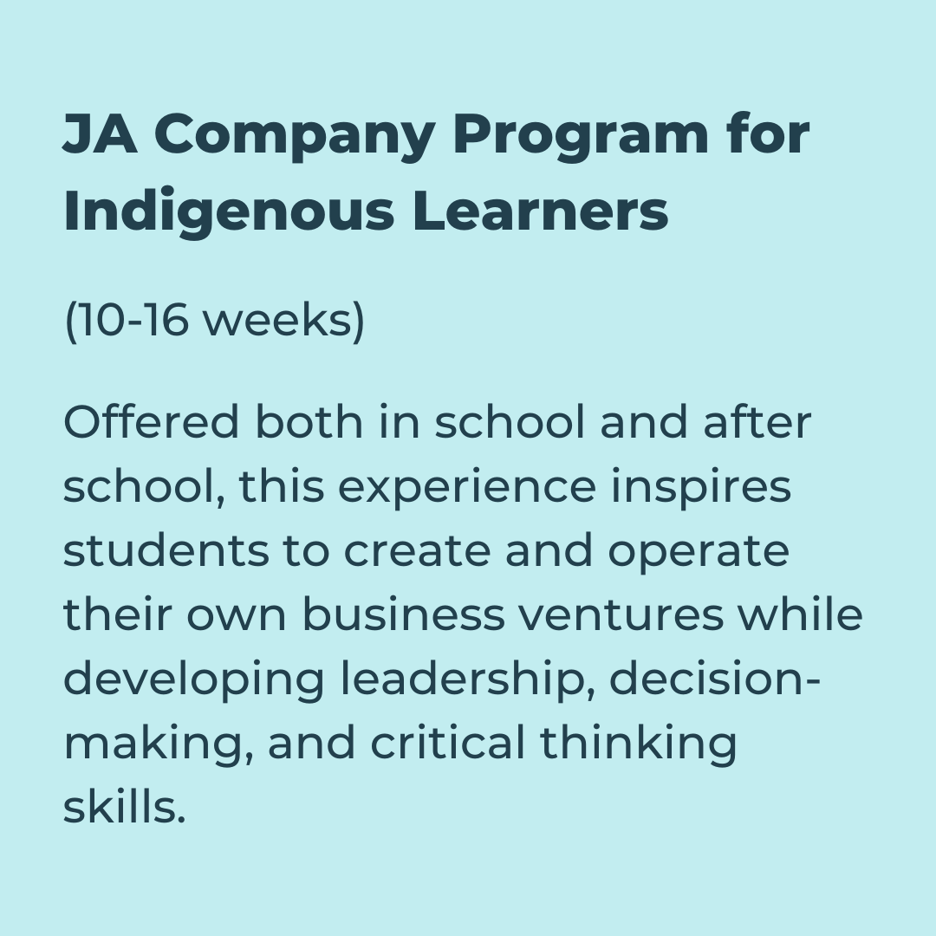
JA Learning Experiences
JA Programs for Indigenous Learners

Slide 8
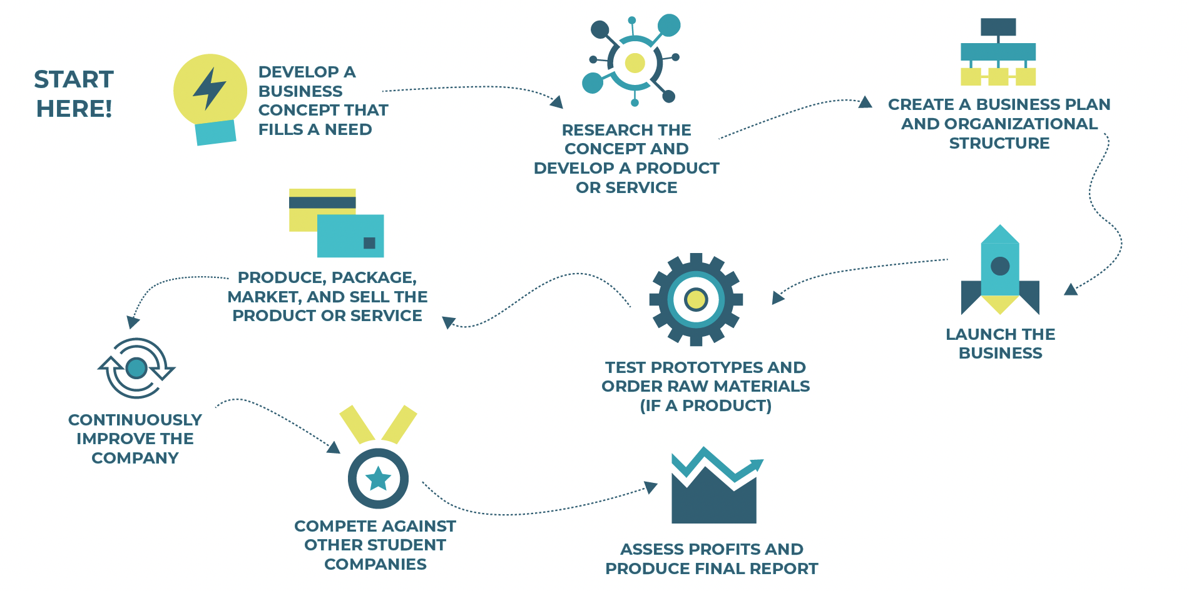
JA Company Program for Indigenous Learners
Empowering Indigenous youth to shape their futures and strengthen their communities.
Adapted from our globally recognized JA Company Program, The JA Company Program for Indigenous Learners equips Indigenous youth with essential business skills to organize and operate their own enterprises.

Slide 9








Snapshot of JA’s Impact
85%
of B.C. School Districts Engaged.
One of our key focuses is strengthening connections with Indigenous schools and communities across the province.

Slide 10
Impact on Young People
More confident about money
JA Canada alumni are 25% less likely to be unemployed and 20% less likely to collect social assistance than are non-alumni. Alumni are also three times less likely to spend more than they earn; they save more and have less debt.

Slide 11
Impact on Young People
More likely to start a business
JA Canada alumni are 50% more likely to open a business. 75% of alumni also stated that JA had a significant impact in the development of their financial literacy and decision-making skills.

Slide 12
Impact on Young People
Improved academic performance
75% of JA Canada alumni stated that JA had a significant impact on their decision to stay in school and enrol in post-secondary education.

Slide 13
Impact on Young People
Awards and Scholarships
Thanks to the generosity of our donors, JABC gives away thousands of dollars in awards and scholarships each year to students who have demonstrated outstanding performance in a JA program.

Slide 14
Contact
Head Office
#570 – 475 West Georgia Street, Vancouver, B.C. Canada V6B 4M9
604-688-3887 | jabc.org
Kimberly Sommer
Program Director, Indigenous Communities
K.Sommer@jabc.org
We acknowledge that our work spans many territories and that our head office resides on the traditional ancestral unceded shared territory of the Musqueam, Squamish and Tsleil-Waututh First Nations peoples.

